Slide 1

17 JULY 2026

Slide 2
What is TCP/IP?
TCP/IP
Set of standardized rules that allow computers to communicate on a network such as the Internet.
When two computers communicate, they need to know ahead of time:
    How do they start the conversation?
      Whose turn is it to communicate?
  How does each computer know its message was transmitted correctly?
  How do they end the conversation?
Notes:
All this happen because of the protocols

Slide 3
What is a protocol?
TCP/IP
A protocol is a collection of rules and procedures for two computers to exchange information
Protocol also defines the format of data that is being exchanged

Slide 4
Why TCP/IP is so popular?
TCP/IP
TCP/IP was developed very early
Technologies were widely discussed and circulated in documents called “Request for Comments” (RFC) – free of charge
Supported by UNIX operating system

Slide 5
How do TCP & IP Differ?
TCP and IP are two separate computer network protocols.
IP is the part that obtains the address to which data is sent.
TCP is responsible for data delivery once that IP address has been found.
Notes:
The IP address is like the phone number assigned to your smartphone.
TCP is all the technology that makes the phone ring, and that enables you to talk to someone on another phone.
They are different from one another, but they are also meaningless without one another.

Slide 6
How does it work?
If the system were to send the whole message in one piece, & encounter a problem, the whole message would have to be resent.
TCP/IP breaks each message into packets
The packets are reassembled on the other end
Each packet could take differ route to the D if initial road unavailable or congested.

Slide 7
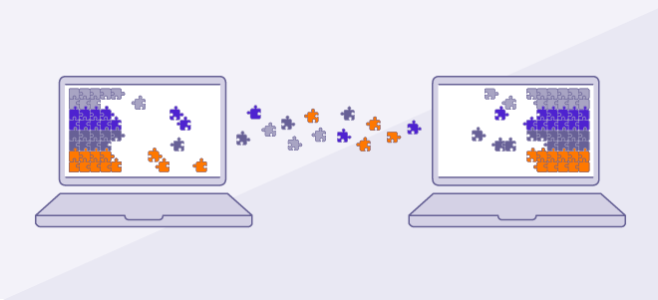
Each layer has a differ function
Data goes through 4 layers before received on the other end.

Slide 8
TCP/IP has 4 layers
Application Layer
Transport Layer
Internet Layer
Datalink Layer

Slide 9
TCP/IP
Application layer protocols define the rules when implementing a specific network application.
Rely on the underlying layers to provide accurate and efficient data delivery
Typical protocols:
  FTP – File Transfer Protocol
    For file transfer
  Telnet – Remote terminal protocol
    For remote login on any other computer on the network
  SMTP – Simple Mail Transfer Protocol
    For mail transfer
  HTTP – Hypertext Transfer Protocol
    For web browsing
7
Notes:
Application layer relies on the underlying layers
Cant determine best path to destination
Cant detect or recover lost packets
Cant convert data into electrical or wireless signals
Cant physically transport data over cables or wi-fi

Slide 10
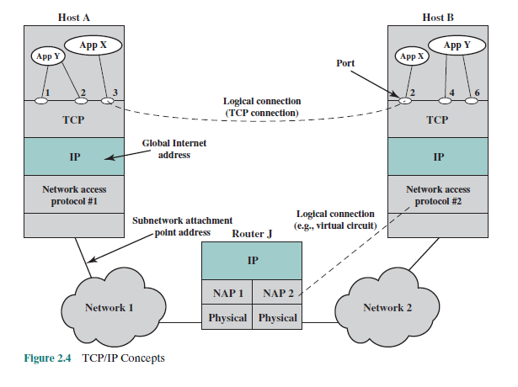
Operation of TCP & IP
Notes:
Notice that many applications can run simultaneously on one computer
Port allows TCP to know which application should receive the data
Logical connection does not represent a physical cable, it shows a virtual communication session between the 2 applications
IP responsible for assigning logical addresses
Routing packets
Delivering packets between networks
This shows that various networks can use various technologies
Router J
Notice there is no TCP & application layer because routers do not run applications
Their job is to receive packets
Examine the destination IP address
Forwards packets to the next network
Virtual circuit – exists

Slide 11
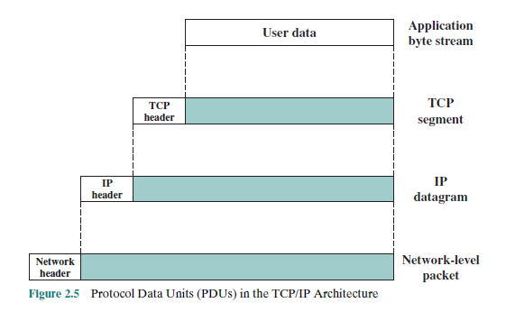
Operation of TCP/IP
Notes:
Shows encapsulation in TCP/IP
App – generates original user data (byte stream)
Tcp layer – adds a tcp header, creating a segment
IP – adds IP header, forming an IP datagram
Network access layer – adds network header creating a network-level packet
At the receiver, each layer removes its header (decapsulation) to recover original user data

Slide 12
TCP/IP
The Transport Layer has two protocols running on top of IP
  TCP – Transmission Control Protocol
    Provide further functions such as reordering and data resend
  UDP – User Datagram Service
    Use when the message to be sent fits exactly into a datagram
    Use also when a more simplified data format is required
8

Slide 13
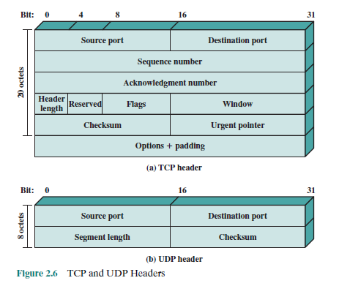
TCP Header & UDP
Notes:
Compares the tcp & udp headers
TCP has a larger, complex header because it provides reliable communication
UDP has a smaller, simpler header for faster transmission
Acknowledgement – confirms receipt of data from sender
Header length – indicates the size of the TCP header
Received for future use
Flags – control connection operations
Checksum – detect transmission errors

Slide 14
TCP/IP
Network layer protocol defines the rules of how to find the routes for a packet destination.
It only gives best effort delivery. Packets can be delayed, corrupted, lost, duplicated, or out of order
Typical protocols:
  IP – Internet Protocol
    Provide logical addressing & packet delivery
  ARP – Address Resolution Protocol
    Translate an IP address into MAC address on a local network.
  ICMP – Internet Control Message Protocol
    Define the procedures of error message transfer
Notes:
ARP works:
Device know the destination IP address
Broadcasts an ARP Request asking, “who has this IP address”?
The device with that IP replies with its MAC address (ARP Reply)
The sender stores the mapping in its ARP cache for future use
ICMP
Reports network errors & diagnostic information
Reports when D is unreachable
Reports when a packet’s Time to Live (TTL) expires
Supports network testing & troubleshooting

Slide 15
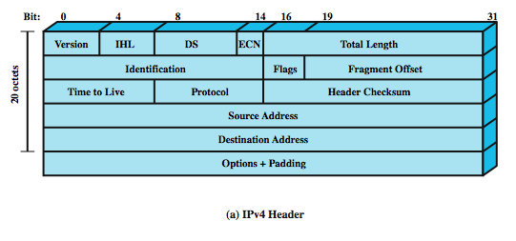
IP Header
Notes:
Contains control information that routers use to deliver packets from s to d
Version → IPv4 or IPv6
TTL → Prevents routing loops
Protocol → Identifies TCP, UDP, or ICMP
Source Address → Sender's IP address
Destination Address → Receiver's IP address

Slide 16
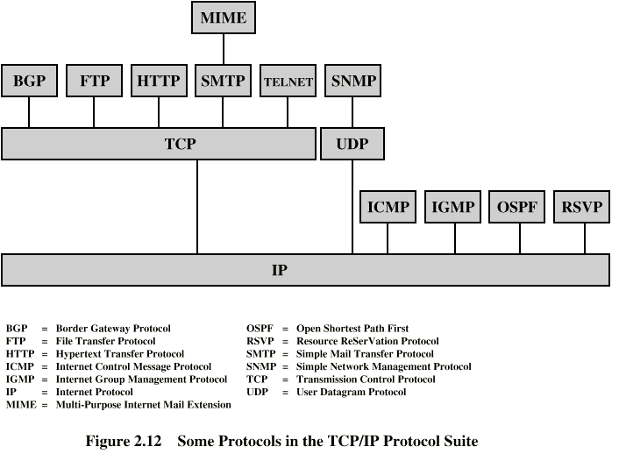
Some TCP/IP Protocols

Slide 17
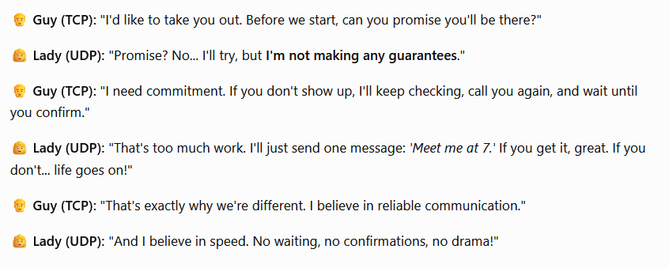

Slide 18

We will dive deeper as time goes on

